Slide 1
Dictionaries

Slide 2
Agenda
What is Dictionary
Getting values from Dictionary
Adding Elements into Dictionary
Removing keys form Dictionary
Dictionary Methods
Dictionary Comprehension

Slide 3
What is Dictionary
Python dictionary is an unordered collection of items. While other compound data types have only value as an element, a dictionary has a key: value pair.
Dictionary are mutable
Syntax: my_dict ={ }

Slide 4
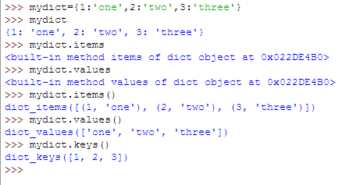
Dictionaries
Python dictionary is an unordered collection of items.

Slide 5
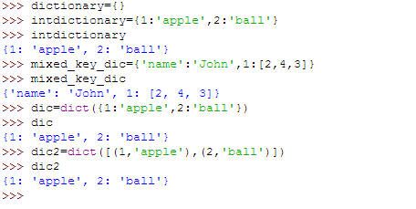
Continue…..

Slide 6
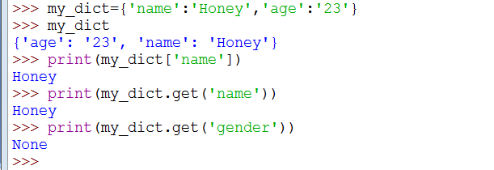
Getting Values from Dictionary

Slide 7
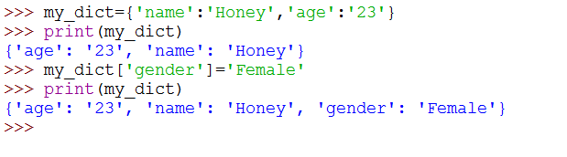
Adding Elements into Dictionary
Dictionary are mutable. We can add new items or change the value of existing items using assignment operator.
If the key is already present, value gets updated, else a new key: value pair is added to the dictionary

Slide 8
Removing Elements from Dictionary:
Pop():We can remove a particular item in a dictionary by using this method.This method removes as item with the provided key and returns the value.
popitem(): can be used to remove and return an arbitrary item (key, value) form the dictionary.
Clear(): All the items can be removed at once using the clear () method.
del: We can also use the del keyword to remove individual items or the entire dictionary itself.

Slide 9
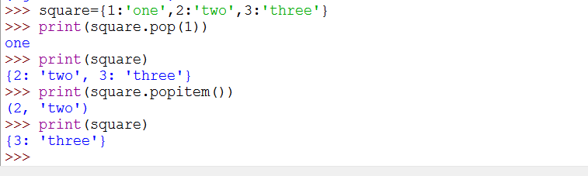


Example

Slide 10
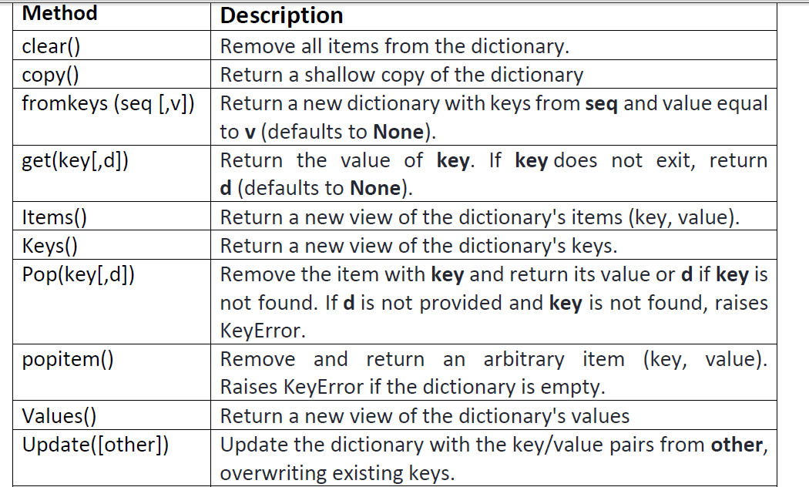
Methods of Dictionary

Slide 11
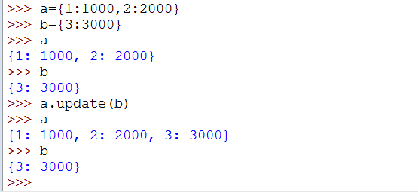
Update
The update() method updates the dictionary with the elements from the another dictionary object or from an iterable of key/value pairs.
The update() method adds element(s) to the dictionary if the key is not in the dictionary. If the key is in the dictionary, it updates the key with the new value.
syntax of update() is:
dict.update([other])

Slide 12
Copy Dictionaries
There are Two ways to Copy Dictionaries
1. Copy()
2. = Operator

Slide 13
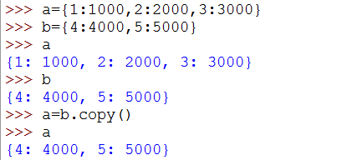
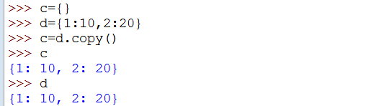
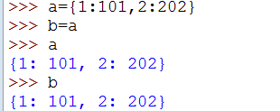
Continue….
They copy() method returns a shallow copy of the dictionary
Syntax of copy() is: dict.copy()

Slide 14
Difference between copy() and = operator
When copy() method is used, a new dictionary is created which is filled with a copy of the references from the original dictionary.
When = operator is used, a new reference to the original dictionary is created.

Slide 15
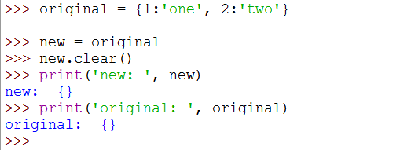
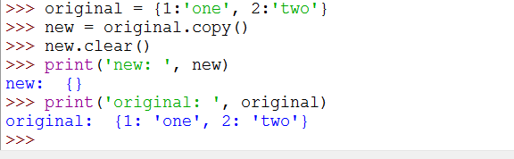
Example
Using = operator
Using copy()

Slide 16
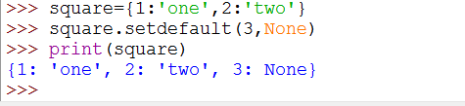
Set-default
Setdefault() is similar to get(), but will set dict[key]=default , if key is not already in dict.
Syntax
dict.setdefault(key, default=None)

Slide 17
Dictionary Comprehension:
Dictionary comprehension is an elegant and concise way to create new dictionary from an iterable in Python.
Dictionary comprehension consists of an expression pair (key: value) followed by for statement inside curly braces {}.

Slide 18

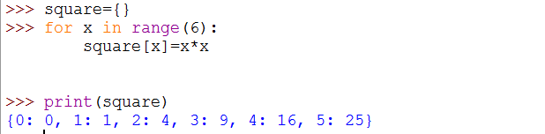
Continue…..
This code is equivalent to

Slide 19
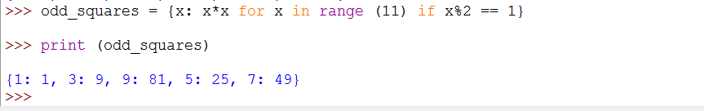
Continue….
A dictionary comprehension can optionally contain more for or if Statements. An optional if statement can filter out items to form the new dictionary. Here are some examples to make dictionary with only odd items.

Slide 20
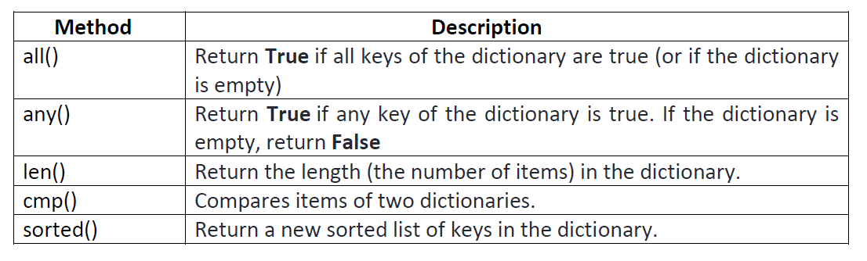
Built-In Functions
Built-in functions like all (), any (), len (), cmp (), sorted () etc. are commonly used with dictionary to perform different tasks

Slide 21
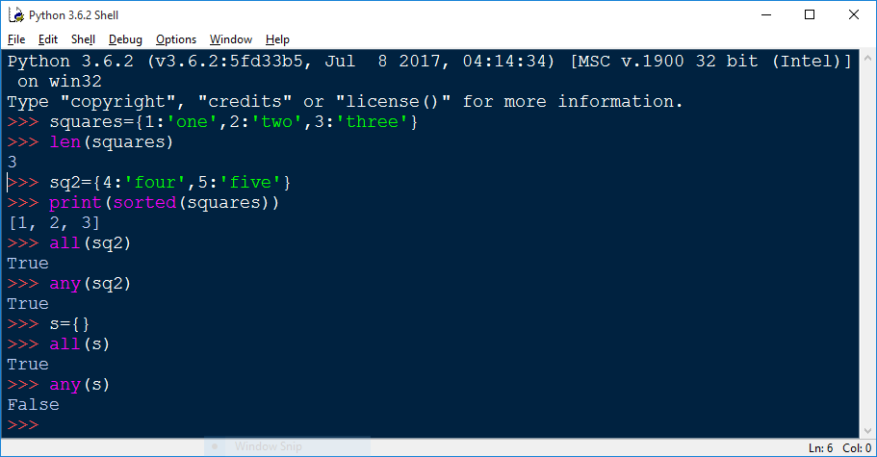
Continue….

